Slide 1
Blockchains

Slide 2

What is a Blockchain?
A blockchain is a decentralized platform that supports transactions with eventual consistency.

Slide 3
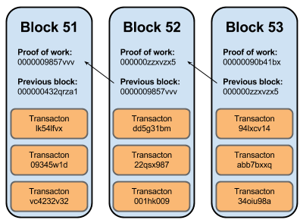
What is a Blockchain?
A continuously growing list of blocks (records) linked & secured using cryptography
This chain of blocks provides an open, distributed ledger that immutably records transactions between two parties efficiently & verifiably

Slide 4
What is a Blockchain?
A block contains a hash pointer as a link to a previous block, a timestamp, & transaction data

Slide 5

What is a Blockchain?
This platform may be distributed globally (public blockchain)

Slide 6
What is a Blockchain?
A blockchain is a decentralized platform that supports “trustless” transactions
It could be localized to a limited group (private blockchain)

Slide 7
What is a Blockchain?
Each node in a blockchain network runs common middleware & all nodes have equal level of privilege

Slide 8
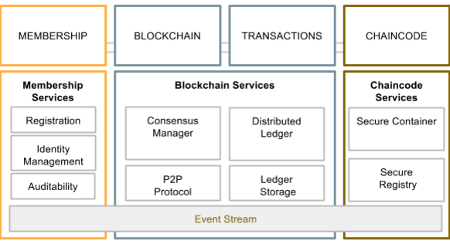
What is a Blockchain?
Blockchain middleware provides services to applications
beyond what's provided by the OS & communication protocols

Slide 9
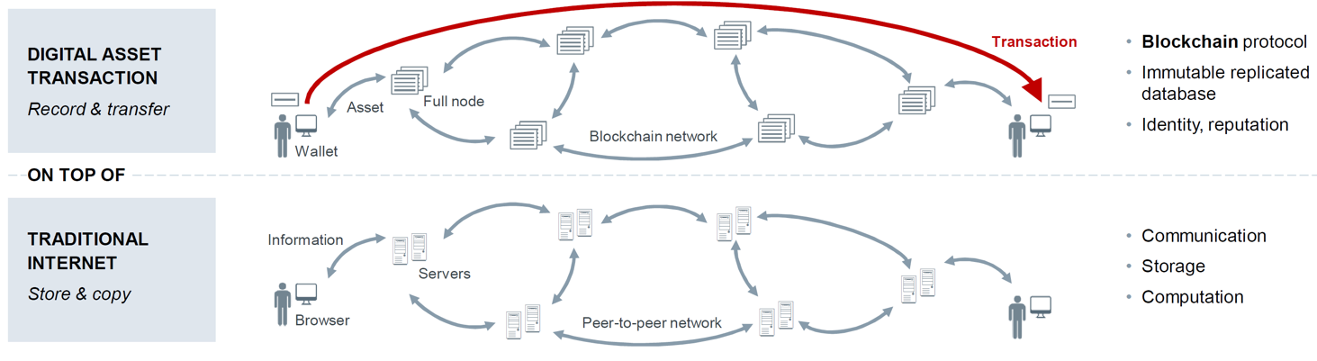
What is a Blockchain?
Blockchain middleware enables anonymous exchange of digital assets without the need for a central authority to verify trust & transfer of value

Slide 10
What is a Blockchain?
Blockchain middleware enables digital asset transactions atop the traditional Internet

Slide 11
What is a Blockchain?
Key characteristics of a blockchain

Slide 12

What is a Blockchain?
The origins of the blockchain prototol are shrouded in mystery!
See medium.com/cryptomuse/how-the-nsa- caught-satoshi-nakamoto-868affcef595

Slide 13
Technical Foundations of Blockchain

Slide 14
Technical Foundations of Blockchain
Blockchains integrates three branches of computer science & mathematics
Cryptography
Game
Theory
Authentication & hashing
Assurance or non-repudiation
Incentivization
Maximizing long-term payoff
Distributed Systems
Byzantine Fault Tolerance
Event Chronology Without Synchronized Clock

Slide 15
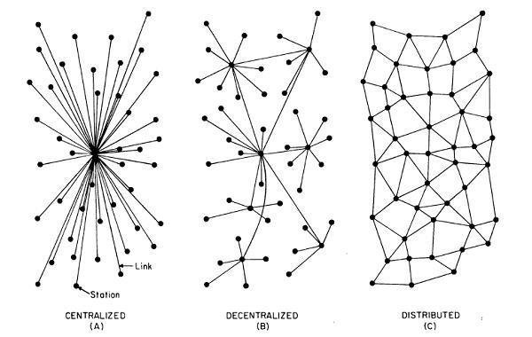
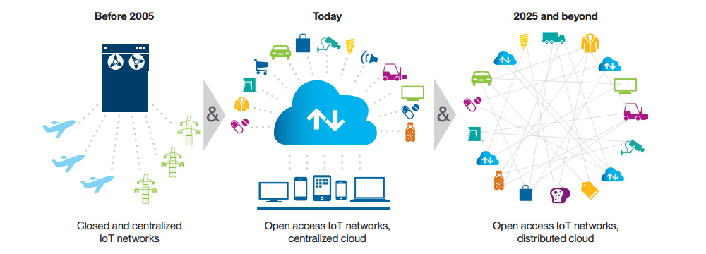
Key Problem: Consistent Record Keeping in Distributed Systems
Centralized Database System
Central authority, exclusive keeper of “ground truth”
Maybe replicated to a redundant stand-by system for higher availability
e.g., traditional Enterprise DB

Slide 16
Key Problem: Consistent Record Keeping in Distributed Systems
Centralized Database System
Distributed Database System
Central authority, exclusive keeper of “ground truth”
Maybe replicated to a redundant stand-by system for higher availability
e.g., traditional Enterprise DB
Consistency mechanisms for guaranteeing completeness & immutability
Full or partial replication
Distributed queries & transactions
e.g., Google Spanner

Slide 17
Key Problem: Consistent Record Keeping in Distributed Systems
Centralized Database System
Distributed Database System
Peer-to-Peer (P2P) Database System
Central authority, exclusive keeper of “ground truth”
Maybe replicated to a redundant stand-by system for higher availability
e.g., traditional Enterprise DB
Consistency mechanisms for guaranteeing completeness & immutability
Full or partial replication
Distributed queries & transactions
e.g., Google Spanner
Decentralized Control
Full or partial replications
Highest reliability, worst latency
e.g., Torrents, Napster

Slide 18
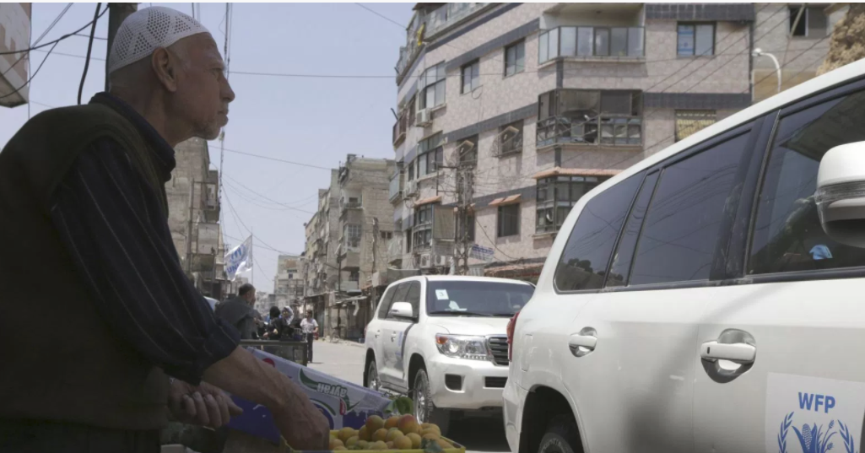
Key Problem: Consistent Record Keeping in Distributed Systems
Peer-to-Peer (P2P) Database System
The UN is using Ethereum’s blockchain technology to provide aid to 1,000s of Syrian refugees in Jordan
Decentralized Control
Full or partial replications
Highest reliability, worst latency
e.g., Torrents, Napster
This architecture is easier to configure & administer for an international relief agency

Slide 19

Looking Deeper in to P2P systems
Network of asynchronously computing nodes
Asynchrony implies responses are not guaranteed, e.g.
Communication can occur at any time & at irregular intervals
Communication delay is not bounded

Slide 20

Looking Deeper in to P2P systems
Network of asynchronously computing nodes
Asynchrony implies responses are not guaranteed
In contrast, synchronous networks have bounded delay
i.e., it is possible to know when a message is lost

Slide 21
Looking Deeper in to P2P systems
Mutual Interest
Consistent copy of database
Any database changes (transactions) must be recorded consistently
There should be no conflicting outcomes
Outcome = transaction applied to database
Stronger property: Everyone should agree on the sequence of transactions
e.g., milk storage & grocery store must both agree that a new bottle has been ordered & delivered

Slide 22
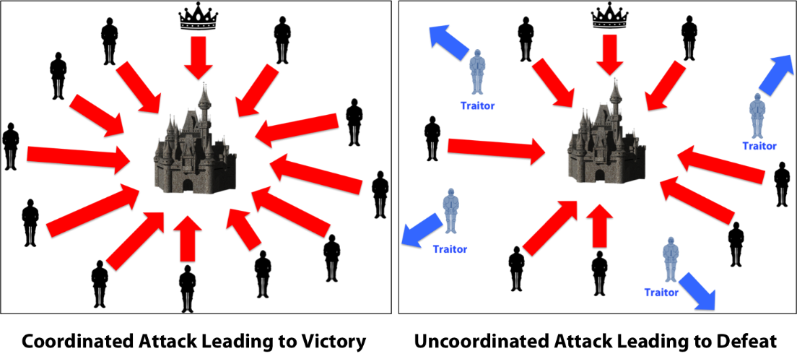
Recall the Byzantine General Problem
Byzantine Generals Problem [Lamport 1982]
Consensus
Assume 9 generals
4 want to attack & 4 want to retreat based on voting
The 9th general says “attack” to one group & “retreat” to other group
The problem is ensuring all 8 loyal generals can agree on the strategy
A small # of traitors should not cause loyal generals to adopt a bad plan

Slide 23

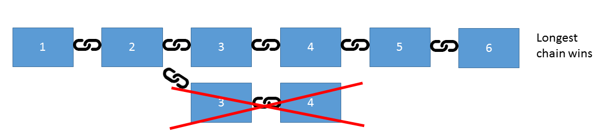
Looking Deeper in to P2P systems
Consensus
The problem is also valid in databases
e.g., how does everybody in network agree that a particular transaction occurred correctly?
The problem also extends to supply chains & products delivered to factories
Immutably linking a product & its subparts to its history

Slide 24
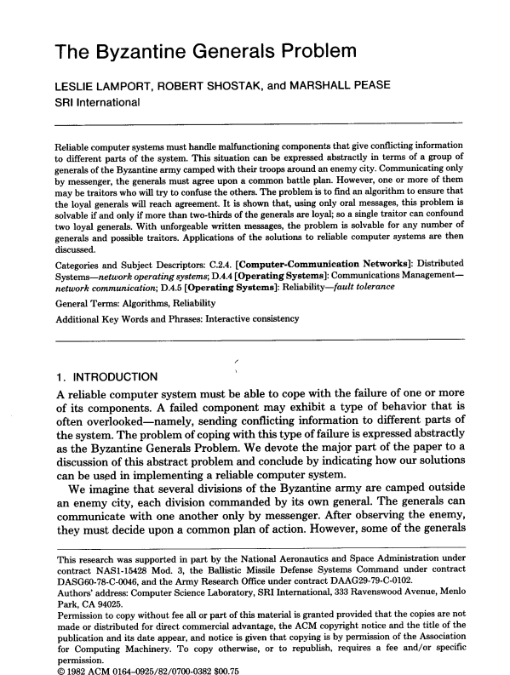
Byzantine General (Consensus) Approaches
Synchronous case [we studied it]
Deterministic solution only if there are more than 3m generals & at most m traitors [Lamport et al 1982]
i.e., at-least 3 generals are required to be part of the group
Intuitively if 1 general is faulty you need input from 2 others to vote him/her out

Slide 25
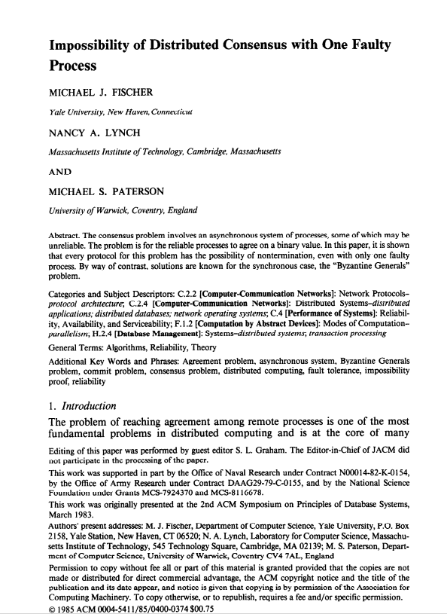
Byzantine General (Consensus) Approaches
Asynchronous case
No deterministic solution of distributed consensus with one faulty process [Lynch et al 1985]

Slide 26
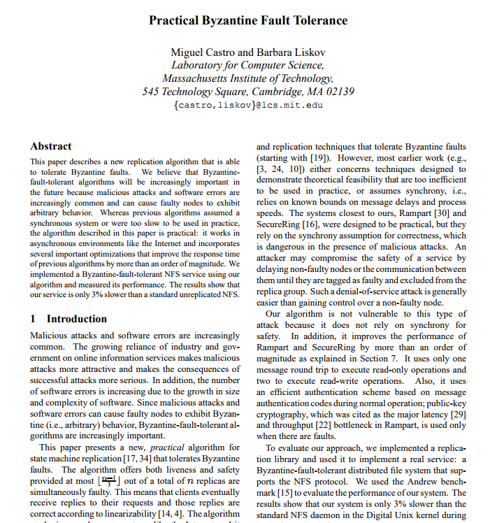
Byzantine General (Consensus) Approaches
Partially synchronous systems
Practical Byzantine Fault Tolerance [Liskov et al 1999]
Advantage
Better Performance
Each participant in the group only waits to hear back from 2m+1 other participants
m is the number of traitors

Slide 27
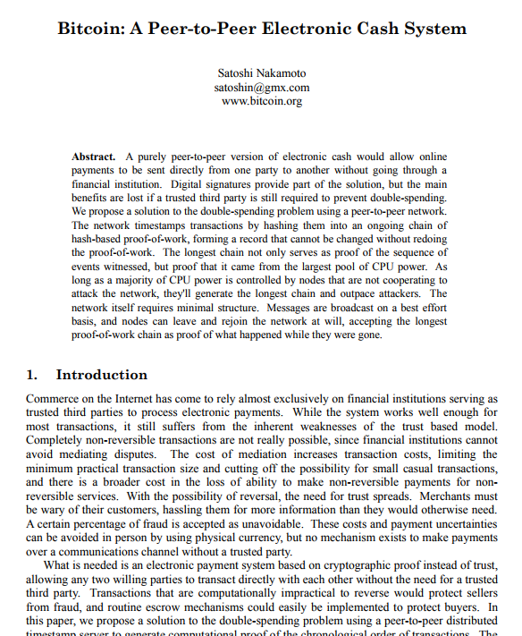
Byzantine General (Consensus) Approaches
Blockchains (Proof of work)
Integration of Incentives & Game Theory to reduce the messaging overhead of practical byzantine fault tolerance [Nakamoto 2008]

Slide 28
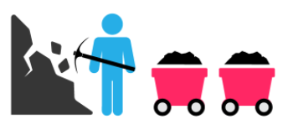

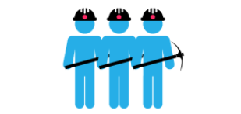
Blockchain – consensus approach
Proof of work requires participants to perform an expensive calculation
Blockchains (Proof of work)
Integration of Incentives & Game Theory to reduce the messaging overhead of practical byzantine fault tolerance [Nakamoto 2008]
Participants issue responses once they validate transaction & group them into a block
Must complete a “hard” puzzle
By investing energy in solving the puzzle, it’s not in their interest to lie
A reward is given to the first miner who solves the problem of a block (recorded in the block)
Everyone competes to solve the mathematical problem first

Slide 29
Byzantine General (Consensus) Approaches
Blockchains
Event sequence is maintained by including a cryptographic hash of previous block into current block
In most cases, HASH(A) == HASH(B) implies A==B
Divergence is possible
Conflicts are broken with the“longest chain” rule
Notes:
A hash function is any function that can be used to map data of arbitrary size to data of fixed size.

Slide 30



How Blockchain Helps Ensure Decentralized Transactions
Seller A
Wait for 6 blocks to be mined
Buyer
Block is rejected
Trying to “double spend”
Seller B
Waits for confirmation

Slide 31
The Blockchain Protocol

Slide 32

A walkthrough of how individual blockchain concepts are interplaying
Example: Bitcoin
Transaction subsystem
Rules of ledger operations
Rules of ledger operations
Rules of ledger operations
Token subsystem
Rules of token handling
Rules of token handling
Rules of token handling
Consensus / database subsystem
Validating full node
Full node
Transaction creation
P2P
message
Transaction
Block
Proof-of-
P2P
message
Block
Appending
validation creation work
validation to database
propagation
propagation
Partial inverse hashing
Cryptography subsystem
PKI addresses, PKI signature
Hashing
Hashing
Hashing
Validity
Eventual finality through consensus

Slide 33
Transaction creation
Signed message between two accounts
Example transaction message
A user, Alice, has a “wallet” containing her public and private keys. This allows her to control multiple bitcoin addresses where bitcoins are stored
A second user, Bob, creates a new bitcoin address to receive bitcoin from Alice, and thus also creates a new key pair
The message is formed according to standard
Bitcoin format
It requires an input, Alice’s account, and several outputs unless the entire content should be sent to Bob. The outputs not going to Bob are then belonging to Alice.
Alice signs the message using her private key, not to hide content but to prove her identity
The transaction is submitted for validation
1.
Alice
Address, public keys
2. | Bob
 | New address, public keys
 | Private keys
Private keys
3. Create message
Message
4. Bob’s account output
4. Alice’s account input
Input
Output
Misc.
Alice
Public keys
Private keys
 | 5.
Message
Input
Output
6. Send message
Sign message

Slide 34
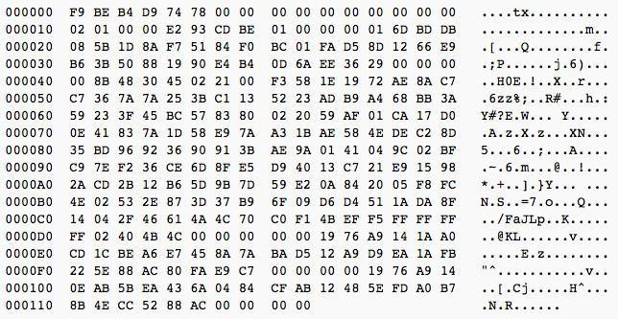
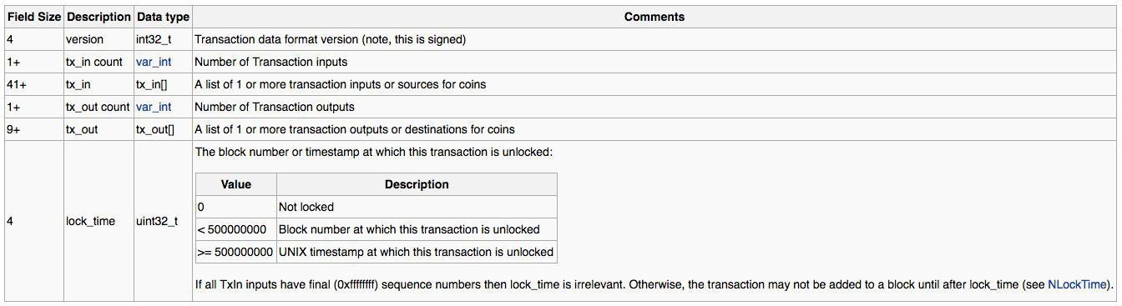
Transaction creation
Description of a transaction
Example transaction message
A transaction is a cryptographically signed message according to the following structure
Transferring a message from one person or entity to another, in such a way that it is:
Message header
Tx version
Previous input
No. of inputs
Signature
script
Publicly visible
Non-retractable
Not doubly spent
No. of outputs
Output 2
Output 1
Structure of a Bitcoin transaction
Locktime

Slide 35
Transaction validation
Validation process of a Bitcoin transaction by every full node
After the Bitcoin transaction has been pushed to the decentralized network, the validation process by the nodes commences
During this process, a series of checks are made through the AcceptToMemoryPool, CheckTransaction & CheckInputs functions in the Bitcoin client.
What is validated?
Signatures – That only owner of account performed transactions from that account
Transaction correctness – That bookkeeping is
correct and no token is spent twice
Examples of checks (first 8 out of 18)
The transactions syntax and data structure are correct
The input and outputs have values.
The transaction is less than the block size of 1 MB
The values must be more than 0 and less than 21
M
None of the inputs have a hash that is equal to 0.
The locktime is less than the maximum allowed
number.
The transaction size is greater than or equal to 100 bytes
The number of signatures is less than the signature limit
9. …

Slide 36
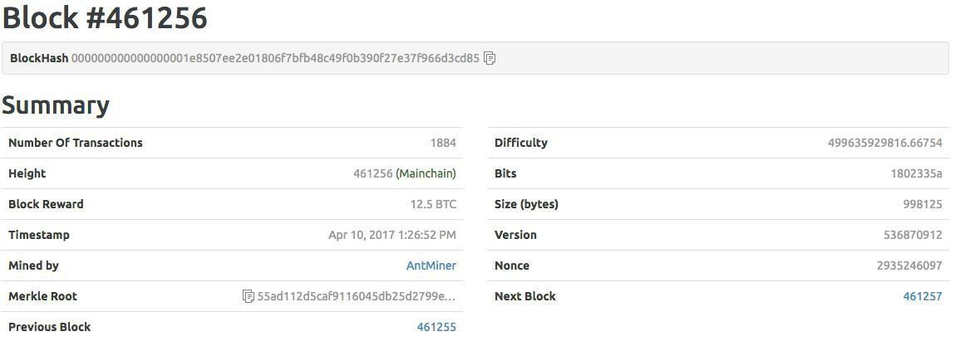
Block creation
Building of block header
Example block
Block #31415
Block size
Block header
No. of
Transactions
Transactions
The block header is built after the hash of transactions is found
Hash prev. block
Hash of txs
Timestamp
Nonce
Version
Difficulty

Slide 37
Content of a block header
Field | Purpose | Gets updated when... | Size
Version | Block version number | You upgrade the software and it specifies a new version | 4
hashPrevBlock | 256-bit hash of the previous block header | A new block comes in | 32
hashMerkleRoot | 256-bit hash based on all of the transactions in the block | A transaction is accepted | 32
Time | Current timestamp as seconds since 1970- 01-01T00:00 UTC | Every few seconds | 4
Bits | Current difficulty target in compact format | The difficulty is adjusted | 4
Nonce Source: bitcoin.wiki | 32-bit number (starts at 0) | The single variable which is possible to adjust in order to reach the difficulty target | 4

Slide 38
Hashing
What is a SHA-256
SHA-256 hash generation
Originally developed by the US National Security Agency (“NSA”)
Secure Hash Algorithm 2 (SHA-2) is a set of cryptographic hash functions, which are mathematical operations
The “256” in SHA-256 indicates the output size in bits, i.e. the larger the target space, the lower the probability of collisions
A cryptographic hash is comparable to afingerprint for a text or a data file
A cryptographic hash is comparable to afingerprint for a text or a data file
SHA-256 algorithm generates an almost-unique, fixed size 256-bit (32-byte) hash
A small change in input leads to a very different output
Input
Output 4731e4b102cea7655
6956b221360fefd2a9
bf01878d977b6567d9
b63bbacce80
9c2fbc64b3ed82ae84 6f958d3962e8bcc477 40500feeb4cf9d5c3d4 6345b2a6b
“This is a Text”
SHA 256
Hash is a one-way function, hence it cannot be
decrypted back (so-called one-way or pre-image
resistant property)
“This is a Test”
SHA 256

Slide 39
For proof-of-work, partial inverse hashing is a bit string lottery
CPU-bound, leading to centralization of compute power (“non-egalitarian”)
Hash prev. block
Search space
0 0 0 0 … 0 0 0 0
Incremental or random walk
1 1 1 1 … 1 1 1 1
Nonce
32 Bit
b b b b … b b b b
Target
71 leading zeros 185 trailing bits
0 0 0 0 … 0 0 0 0 b b b b … b b b b
Difficulty
Hash of txs
Entire block header
Timestamp
256-bit number
SHA-256
?
Nonce
Version
Difficulty
Block header
b b b b … b b b b
SHA-256
b b b b … b b b b
Parallelization for speeding up
SHA-256
…
…
b b b b … b b b b
SHA-256
b = 0 or 1; CPU: central processing unit; SHA: secure hash algorithm

Slide 40
Example of proof-of-work
Challenge
Goal
Let us assume that the basic string that the example is going to work on is: „Hello, world!“. This would be the block in reality.
Our goal is a variation starting with “Hello, world!” preceded by numbers beginning with “0000”. This is the difficulty, the more 0’s, the more difficult.
Input
SHA-256 hash
Hello, world!
315f5bdb76d078c43b8ac0064e4a0164612b1fce77c869345bfc94c75894edd3
Hello, wordl!1
e9afc424b79e4f6ab42d99c81156d3a17228d6e1eef4139be78e948a9332a7d8
Hello, wordl!2
ae37343a357a8297591625e7134cbea22f5928be8ca2a32aa475cf05fd4266b7
…
…
Hello, world!4249
c004190b822f1669cac8dc37e761cb73652e7832fb814565702245cf26ebb9e6
Hello, world!4250 0000c3af42fc31103f1fdc0151fa747ff87349a4714df7cc52ea464e12dcd4e9
A single change to the basic string leads to an entirely different outcome in form of SHA-256 hash
It took 4,251 tries to find a variation starting with “0000” in SHA-256 hash

Slide 41





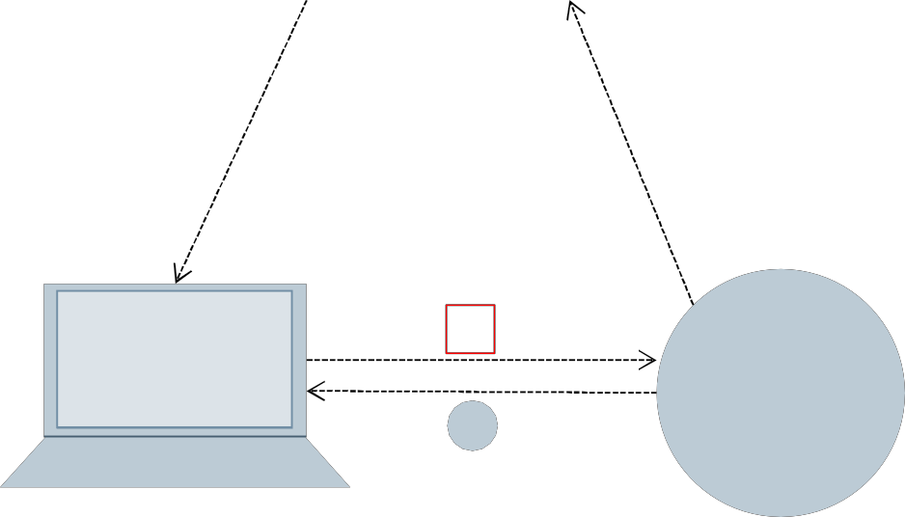
Rewards and incentivization – important for consensus
Whoever solved the block and found the right nonce gets rewarded
As bitcoin is a coin-based transaction network, new coins gets issued to the successful miner (i.e. to the Bitcoin system)
This reward is a compensation for the successful miner (node) for using a significant amount of computational power (especially hardware and electric power) to come up with the proof-of-work
In addition, the succeeded miner also receives the transaction fee that is charged for each Bitcoin transaction
The current Bitcoin reward for solving 1 block is
12.5 Bitcoin (this was 50 Bitcoin at the beginning
but is halved every 210,000 blocks)
Reward system
Bitcoin rewards
Miner s
Transaction
Transaction
Right hash
Bitcoin
Miner PC
Reward
(12,5 XBT)

Slide 42
Block Example.
Open SimpleBlock and Proof of Work Notebooks

Slide 43
Merkel Tree
How Blocks are actually handled and stored.

Slide 44
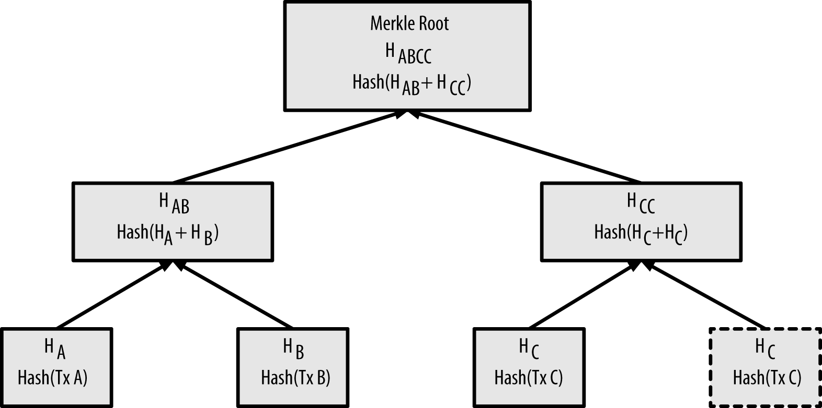
Merkle Tree
The merkle tree is constructed bottom-up. Consider an example,
we start with four transactions, A, B, C and D, which form the leaves of the Merkle tree,
The transactions are not stored in the merkle tree; rather, their data is hashed and the resulting hash is stored in each leaf node as H_{A}, H_{B}, H_{C}, and H_{D}:

Slide 45
Merkle Tree
Each block in the bitcoin blockchain contains a summary of all the transactions in the block, using a merkle tree.
A merkle tree, also known as a binary hash tree, is a data structure used for efficiently summarizing and verifying the integrity of large sets of data.
Merkle trees are binary trees containing cryptographic hashes.

Slide 46
Merkle Tree
H~A~ = SHA256(SHA256(Transaction A))
H~AB~ = SHA256(SHA256(H~A~ + H~B~))
Consecutive pairs of leaf nodes are then summarized in a parent node, by concatenating the two hashes and hashing them together.
For example, to construct the parent node H_{AB}, the two 32-byte hashes of the children are concatenated to create a 64-byte string. That string is then double-hashed to produce the parent node’s hash.
The process continues until there is only one node at the top, the node known as the Merkle root. That 32-byte hash is stored in the block header and summarizes all the data in all four transactions.
Because the merkle tree is a binary tree, it needs an even number of leaf nodes. If there is an odd number of transactions to summarize, the last transaction hash will be duplicated to create an even number of leaf nodes, also known as a balanced tree.

Slide 47
Why Merkele Tree
A Merkle tree is just an efficient way to prove that something is in a set, without having to store the set.
Each non leaf node of a Merkle tree is just the hash of the concatenation of it's children.
Each of the leaves are the set we want to prove membership for.
In a sense, the root of the Merkle tree is a digest of all of the elements in the data set.
Say person A contains the root node of the Merkle tree for set S, and person B wants to convince person A that element E is in S.
To do this, person B only has to provide person A with the siblings of all of the elements in the tree in the path from E to the root node.
This is only log(n) nodes. So B only has to provide log(n) pieces of data, and person A only has to store the root node.
With this provided information, person A can recompute the root node of the tree, and check to make sure that it matches the one that he knows is correct. If the hash function is collision resistant, then he can be sure that E is in S.

Slide 48
Smart Contracts

Slide 49
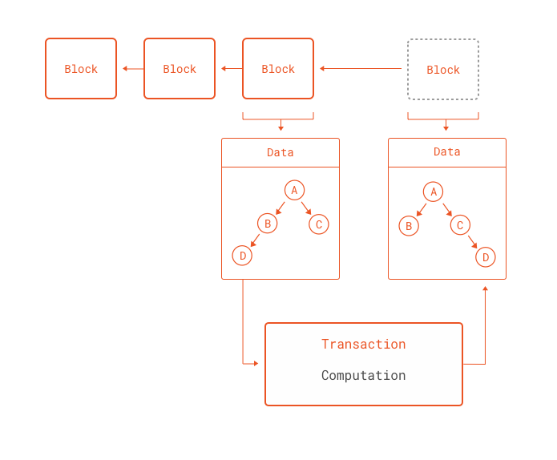
Blockchains are more than coin transaction…
Blockchains deal with reaching consensus for decentralized computations, it does not matter what those computations are
This is exactly what the Ethereum network brings to the table: a blockchain that can perform any computation as part of a transaction.

Slide 50
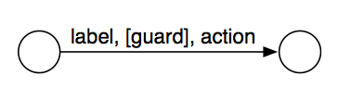
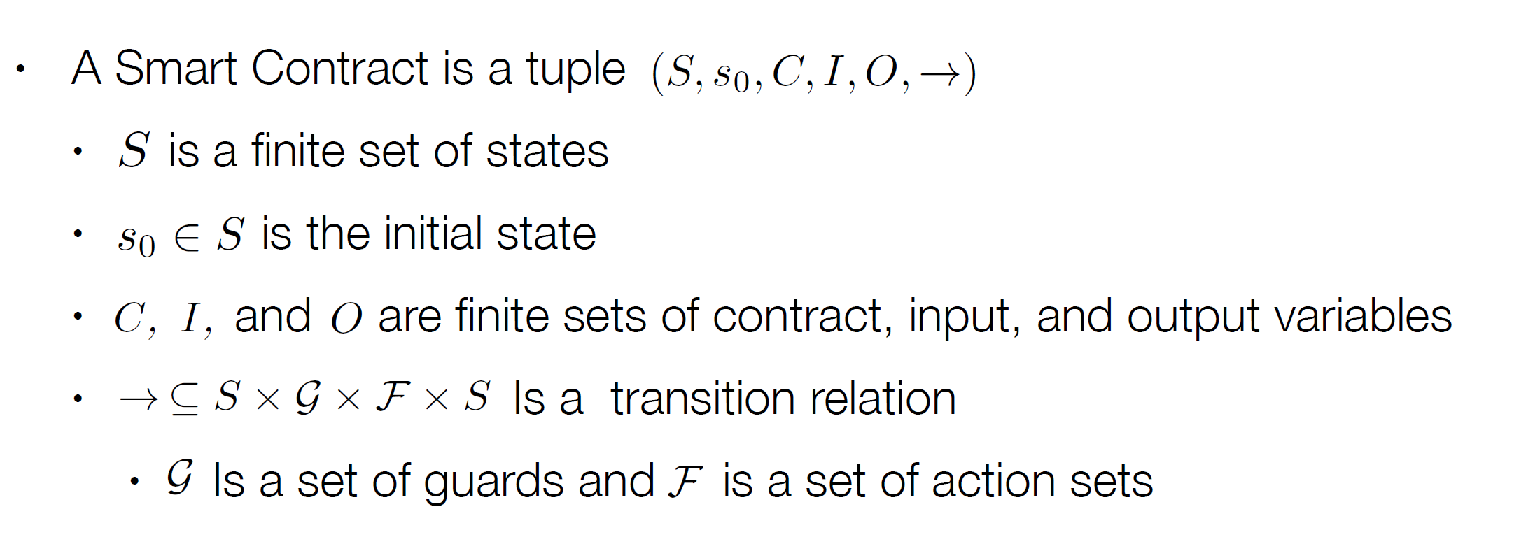
Smart Contract – Formal Definition

Slide 51
Smart Contracts
There are many other applications where distributed, secure computations make sense
Secure deposits that get returned to the payer if conditions are met (or not)
Money that cannot be spent unless a certain number of users agree to spending it
Money that can only be spent after producing external data that satisfies rules set in the script

Slide 52
Simple Example

Slide 53
Solidity
Solidity is a JavaScript-like language developed specifically for writing Ethereum Smart Contracts.
The Solidity compiler turns this code into Ethereum Virtual Machine bytecode, which can then be sent to the Ethereum network as a transaction to be given its own address.
https://remix.ethereum.org
Visit https://ethereumbuilders.gitbooks.io/guide/content/en/solidity_tutorials.html for tutorials on solidity
https://www.dappuniversity.com/articles/solidity-tutorial

Slide 54
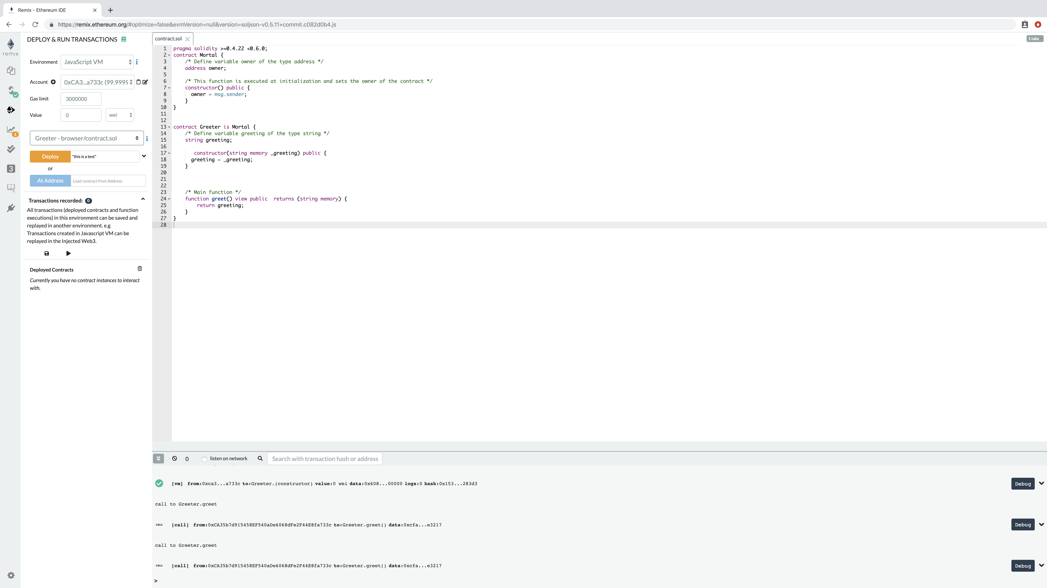
Remix site simple example.
pragma solidity >=0.4.22 <0.6.0;
contract Mortal {
/* Define variable owner of the type address */
address owner;
/* This function is executed at initialization and sets the owner of the contract */
constructor() public {
owner = msg.sender;
}
}
contract Greeter is Mortal {
/* Define variable greeting of the type string */
string greeting;
constructor(string memory _greeting) public {
greeting = _greeting;
}
/* Main function */
function greet() view public returns (string memory) {
return greeting;
}
}
Notes:
Please run it. The idea is to deploy and then call the greet function

Slide 55
Example – Transactive Energy
Scott – Take the slides from TRANSAX and explain the concept.
Actually start this whole discussion by talking about this first
Notes:
Spend 15 – 20 min on transax
Why sc required? What is a use case?
Checks wo centralized node
Can handle failures
Fgh 132

